Slide 1
WHY WE EXIST:
CREATING MORE ECONOMIC SECURITY FOR MORE NEW ORLEANIANS
Investor Luncheon Presentation
June 22, 2017
Notes:
Echo Henry’s thanks.
Acknowledge Board, City, Investors and a big thanks to Harrah’s for their generous contribution of the room and working to make this possible for us all.

Slide 2
Special Thanks to Our Current Investors
Leadership Investors ($20,000+)
City of New Orleans
Entergy New Orleans
First NBC
Harrah’s New Orleans
JPMorgan Chase Foundation
LCMC Health
Leslie Jacobs
Shell Oil Company
Surdna Foundation
Foundational Investors ($10,000+)
Adams and Reese, LLP
Barriere Construction Co., LLC
Business Council of New Orleans & The River Region
Capital One
Coaxum Enterprises, Inc.
Downtown Development District
Goldring Family Foundation
Helis Oil & Gas Company, LLC
IBERIABANK
Jones Walker LLP
Laitram, LLC
Liberty Bank
New Orleans Saints and New Orleans Pelicans
RazorLine, LLC
Transdev Services, Inc.
Whitney Bank
Partner Investors ($5,000+)
Baker Donelson
Bellwether Technology
Boh Bros. Construction Co., LLC
Canal Barge Company, Inc.
Enwave USA (New Orleans)
FOGO Data Centers
HCA MidAmerica Division, Tulane Health System
The Kearney Companies, Inc.
Laurel Outdoor
New Orleans Board of Trade
Phelps Dunbar, LLP
Port of New Orleans
Postlethwaite and Netterville
Stirling Properties, LLC
Stone Pigman Walther Wittmann, LLC
Transcendent Legal
Transoceanic Development, LLC
Woodward Design+Build
Supporting Investors (Up to $5,000)
ADP
AT&T
Aimee M. Quirk
Algiers Development District
Annala + Wills, LLC
Benefit Administration Group
The Boeing Company
The Domain Companies
ERG Enterprises
Ernst & Young, LLP
First Hartford Realty Corporation
Howard Hughes Corporation, The Outlet Collection
Hyatt Regency New Orleans
John C. Hope III
Mathes Brierre Architects
MCC Real Estate Group
McKenna Museum of African-American Art
Mr. and Mrs. Quentin L. Messer, Jr.
Perez Architects
Rebecca Conwell
Sherman Strategies
Signs Now
Solomon Group
Southwest Airlines
Notes:
Removing :
Algiers Economic Development Foundation, last contribution was in 2015
Health Education Authority of Louisiana, last contribution was in 2015
PSAV, last in-kind contribution was in 2015
Removing HRI Properties, last contribution was in 2015
Adding:
AT&T, $2000 for Fall 2017 Ambassadorship Program
Benefit Administration Group, $1000 for Fall 2017Ambassadorship Graduation Reception
McKenna Museum of African-American Art, In-kind donation
ERG Enterprises, Spring 2017 Ambassadorship Program
GNO, Inc. , Pass through revenue
The Outlet Collection, ReCON
Rebecca Conwell, 2017
Humana, 2016
First NBC, 2017
Category Change
Adams & Reese, contributed over $5k, moving to Foundational Investor
Downtown Development District, contributed 10k in 2017, moving to Foundational Investor

Slide 3
NOLABA Board of Directors
Executive Committee
Henry L. Coaxum Jr.
Chair
President, Coaxum Enterprises, Inc.
Aimee Quirk
Vice Chair
CEO, innovationOchsner
Justin T. Augustine III
Treasurer
Vice President, TransDev Services, Inc.
Kim M. Boyle, Esq.
Secretary
Partner, Phelps Dunbar, LLP
*Hon. Mitchell J. Landrieu
Mayor of the City of New Orleans
*Rebecca Conwell
Mayoral Designee, Sr. Advisor for Economic Development, City of New Orleans
Michael W. Kearney Sr.
President and CEO, The Kearney Companies, Inc.
Thomas Mabon
Senior Vice President, IBERIABANK
Charles L. Rice, Jr.
President and CEO, Entergy New Orleans, Inc.
Board Members
R. Erich Caulfield
President, The Caulfield Consulting Group
Greg Feirn
CEO, LCMC Health
Rita LeBlanc
Owner, Bold Sphere
Michael Smith
General Manager, Hyatt Regency New Orleans
Richard Tallant
General Manager – Gulf of Mexico East, Shell Exploration and Production Company
Hon. Jason R. Williams, Esq.
Councilmember-at-Large, New Orleans City Council
Robert Wollfarth, Esq.
Shareholder, Baker Donelson

Slide 4

April 2017, NOLABA became only the fourth Accredited Economic Development Organization (AEDO) in LA; fewer than 70 AEDOs worldwide
The Accredited Economic Development Organization (AEDO) program was created by the International Economic Development Council (IEDC) as a means of recognizing the professional excellence of economic development entities worldwide.
Becoming an AEDO is the “Good Housekeeping Seal” for economic development organizations and business location consultants take cities with an AEDO more seriously when advising companies on relocation
AEDOs: an elite network that is the “best of the best” in the profession.

Slide 5

ELEVATING NEW ORLEANS AS A BIO REGION
In April, Provision Healthcare chose New Orleans to build the Louisiana Proton Therapy Center, showing the city’s continued growth as a destination for healthcare.
Notes:
New Orleans started as one of 50 cities being considered for the project. Groundbreaking is scheduled for later this year and opening in 2019.
Projections: About 60 new direct jobs will be created and another 60 indirect jobs.
New Orleans is one of only 15 U.S. cities with two medical schools, so we’ve got the talent pipeline they need.

Slide 6
WhyNOLA Campaign Evolves: Videos
NEW ORLEANS BUSINESS PEOPLE TALK
“WHY NOLA” FOR BUSINESS
Notes:
#WhyNOLA?
For the past year we’ve continued to improve our outreach to local business people, especially entrepreneurs, to tell their personal stories of how they built their businesses and careers in New Orleans because in New Orleans you can pursue your professional goals WHILE having a very interesting life.
Tactics:
Social media - #WhyNOLA. Posts include short videos of no more than 30 seconds and graphics with testimonial quotes.
Facebook Ads targeted to audiences for each of NOLABA’s industry clusters.
WhyNOLA Blog is taking the form of monthly Q&As. Marketing communications manager Rachel Whittaker is doing the outreach to entrepreneurs, and Amy Ferguson leads production of videos with production company Fresh Media.
Rachel is working with a part-time digital strategist (Tiffany Starnes) and part-time creative director (Jill Norman).

Slide 7
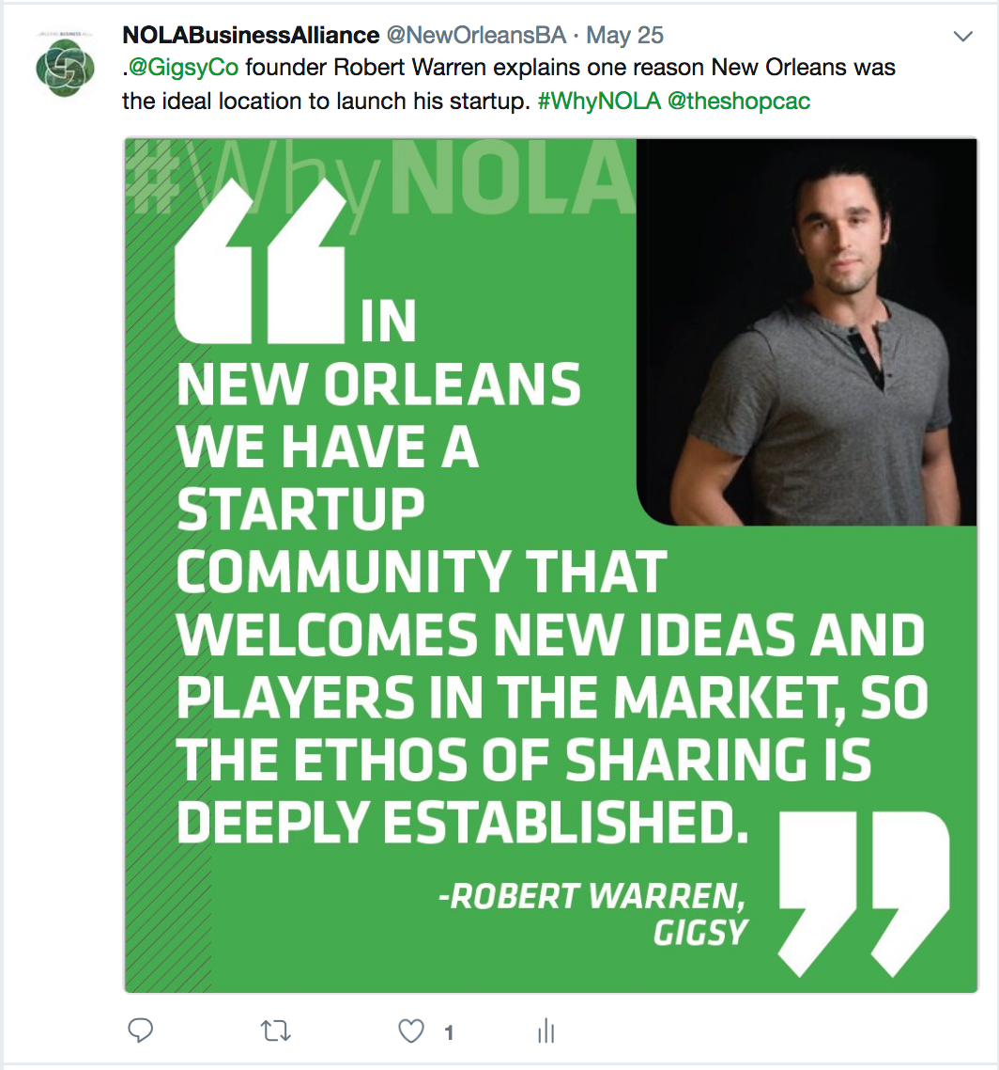
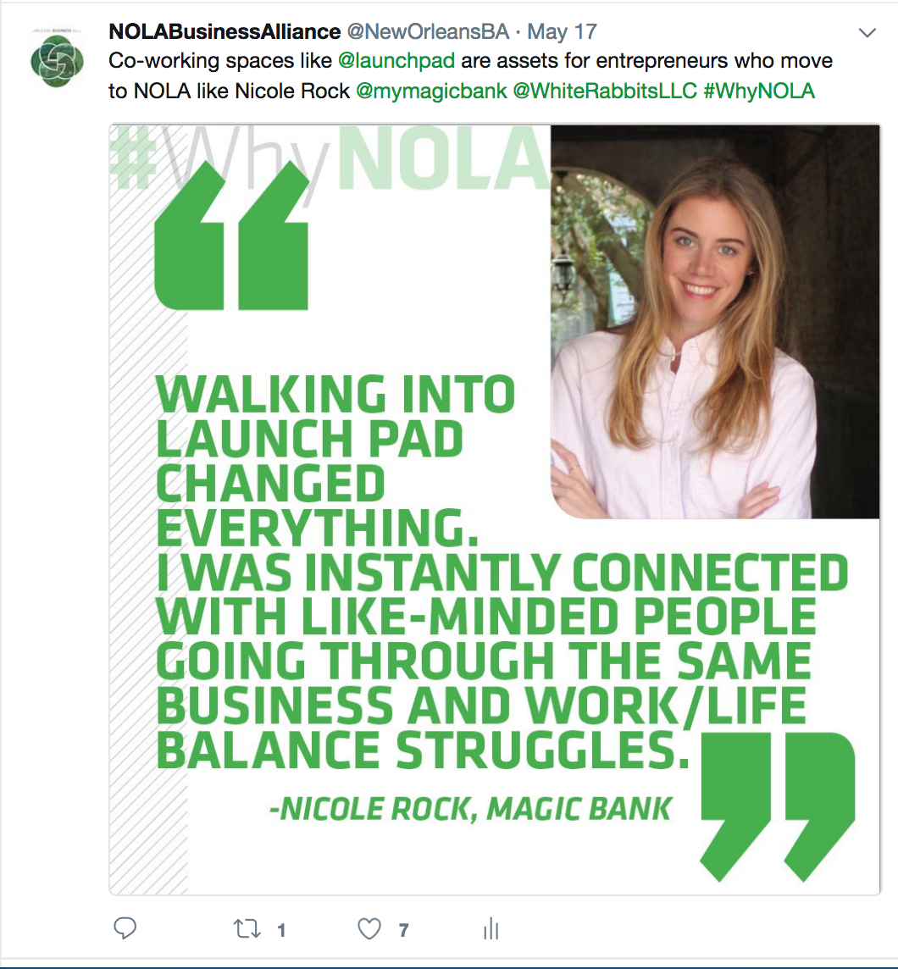
WhyNOLA Campaign Evolves: Graphics
Notes:
#WhyNOLA?
For the past year we’ve continued to improve our outreach to local business people, especially entrepreneurs, to tell their personal stories of how they built their businesses and careers in New Orleans. In New Orleans you can pursue your professional goals WHILE having a very interesting life.
Tactics:
Social media - #WhyNOLA. Posts include short videos of no more than 30 seconds and graphics with testimonial quotes.
WhyNOLA Blog is taking the form of monthly Q&As. Marketing communications manager Rachel Whittaker is doing the outreach to entrepreneurs, and Amy Ferguson leads production of videos with production company Fresh Media.
Rachel is working with a part-time digital strategist (Tiffany Starnes) and part-time creative director (Jill Norman).
Why “#WhyNOLA” - Talking Points
The over-arching strategy of this campaign is not only to pose the question, but answer it via positive stories of businesspeople that saturate the community via traditional, guerrilla and digital mean.
We will keep producing positive content for the foreseeable future in order to ensure momentum.
We’d love to hear your ideas and your stories.

Slide 8

#WhyNOLA Campaign Evolves: Partnerships
NOTMC has partnered to produce a series:
“GoNOLA Presents #WhyNOLA – a project of the New Orleans Business Alliance”
We are rolling out their content this summer on NOLABA.org and social media,
starting with Music Box Village and Joy the Baker.
Notes:
The over-arching strategy of this campaign is not only to pose the question, but answer it via positive stories of businesspeople that saturate the community via traditional, guerrilla and digital mean.
We will keep producing positive content for the foreseeable future in order to ensure momentum.
We’d love to hear your ideas and your stories.

Slide 9
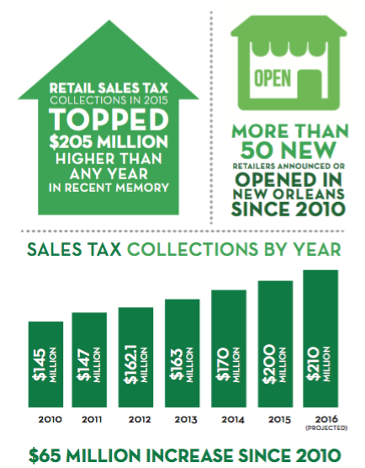

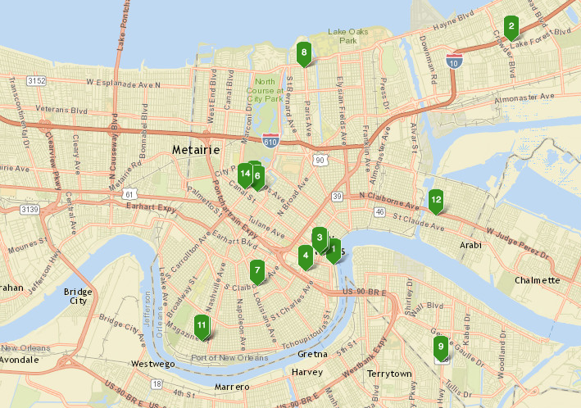
RETAIL’S CONTINUED IMPACT: NOLABA’s initial focus, remains critical given the direct impact to the City coffers; sales tax leakage reduced by city’s retail growth
Since 2010
More than 50 new retailers have announced or opened in New Orleans
$65M increase in local sales tax collection

Slide 10
Small Business 2017 Impact Plan:
Dedicated Senior Staffperson Focused Solely on Small Business
Plan for 2017 Impact:
Collaborate with Business Ecosystem Partners
Provided assistance to City of New Orleans Department of Economic Development immediately after the recent tornado (locating critical supplies; collective strategizing, etc.)
  Contacting business owners in the footprint of the disaster,
  ascertaining their status, extent of damage and immediate needs and apprising them of available assistance, i.e. FEMA and SBA.
  Currently compiling a listing of businesses effected for further assistance and follow-up.
Develop for dissemination to small business owners, an inclusive listing of available business resources. Listing will also be posted on NOLABA’s website. Also connecting small business owners to the most effective business resources based on their level of need.
Convene a monthly Roundtable of Business Technical Assistance Providers, Financial, Public and other Partners to collectively identify strategies leading to solutions to issues that prevent small businesses from growing, accessing capital and creating jobs.
Participate on the commercial corridor revitalization strategy committee.

Slide 11

OPPORTUNITIES FOR ADDITIONAL
ENGAGEMENT WITH NOLABA
New & Ongoing Initiatives
#WhyNOLA Campaign
BIO Health Innovation Challenge – in partnership with MedStartr – kickoff event July 6
Retail Real Estate Breakfasts monthly
Notes:
Many ways for you to continue or increase your involvement
Small Business Symposium – Lynnette White-Colin was on WWL in May talking about how this is a landmark event for NOLABA to host. We’re having speakers as far away as Chicago come to speak about their small business growth strategies, so we’re looking forward to it.

Slide 12
NOLABA STAFF
LEADERSHIP
Quentin L. Messer, Jr.
President & CEO
BUSINESS DEVELOPMENT
Brenda Canada
Vice President, Retail Attraction, Development & Strategy
Louis David
Vice President, Business Development & Strategy, Digital Media/Software
Amritha Appaswami
Vice President, Business Development & Strategy, BioInnovation & Health Services
Lynnette White-Colin
Director, Small Business Ecosystem Development
Shantell Brown
Coordinator, Small Business Ecosystem Development
Katy Dupre
Manager, Economic Competitiveness
Marketing & Communications
Rachel Whittaker
Manager, Marketing & Communications
PERFORMANCE & SUPPORT
Ken Weatherup
Vice President, Human Capital & Culture
Alejandra Guzman
Vice President, Program Development & Strategy
Stephanie Bell
Director, Investor Relations
Lisa Hellrich
Special Assistant
Dominique Flugence
Finance Associate
504WARD
Mary Matthews
Executive Director
Notes:
Welcome aboard 3 newest full-time employees:
Stephanie Bell, Director of Investor Relations;
Shantell Brown, Small Business Ecosystem Development Coordinator;
Rachel Whittaker, Marketing Communications Manager

Slide 13




FOLLOW NOLABA ON SOCIAL MEDIA:
@nolabusinessalliance
New Orleans Business Alliance
@NewOrleansBA
New Orleans Business Alliance

Slide 14
THANK YOU
Quentin L. Messer, Jr.
President & CEO
qmesser@nolaba.org
Stephanie Bell
Director, Investor Relations
sbell@nolaba.org

Slide 15
2017 Programming Initiative: New Orleans Economic Development Ambassadorship Program
PURPOSE: Equip more New Orleanians to be advocates for the local economy to let the world know that New Orleans is open for business
Program Delivery
  Six sessions over a 7-week period delivered by NOLABA staff members and those of selected partner organizations
  Presented topics cover the major areas of economic development (e.g., business attraction and retention, entrepreneurship, talent attraction and retention)
Participant Profile
  Experienced mid-career professionals passionate about New Orleans’ future who desire to become better informed ambassadors for the city
  We had 49 applicants in spring 2017 from which a class of 26-28 was selected by a panel of economic development professionals
Notes:
Purpose of the program is to equip mid-career professionals in New Orleans to be advocates for the local economy by giving them an insider’s perspective into our intentional strategies for growing and diversifying the city’s economy.
The program is increasing to 7 weeks – Tuesday evenings from Sept. 5-Oct. 17, culminating with a graduation reception.
Early bird application deadline is July 21. Final deadline August 1.
Sponsorship opportunities are available. Talk to me or Mary Matthews, or visit our website for more details.

Slide 16
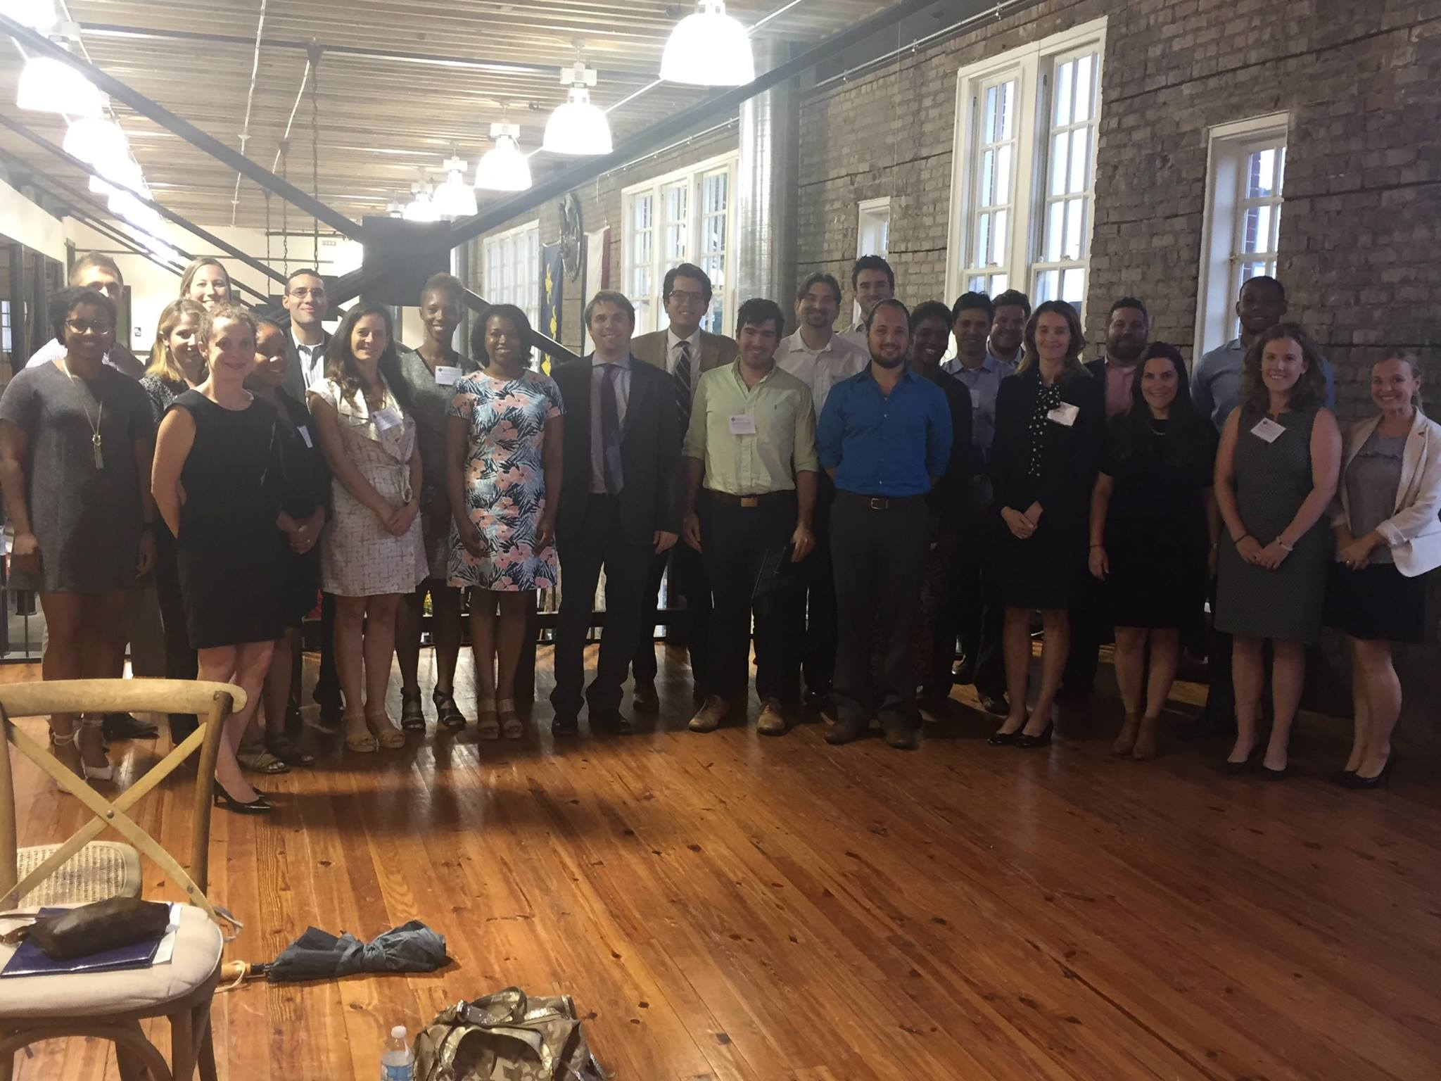
ECONOMIC DEVELOPMENT
AMBASSADORSHIP PROGRAM
Spring cohort was a great success.
Applications are open until August 1 for the fall session, which starts September 5.
We have launched a page about the program on our website and regularly post testimonials on social media.
Notes:
Purpose of the program is to equip mid-career professionals in New Orleans to be advocates for the local economy by giving them an insider’s perspective into our intentional strategies for growing and diversifying the city’s economy.
The program is increasing to 7 weeks – Tuesday evenings from Sept. 5-Oct. 17, culminating with a graduation reception.
Early bird application deadline is July 21. Final deadline August 1.
Sponsorship opportunities are available. Talk to me or Mary Matthews, or visit our website for more details.

